Slide 1
ONLINE HOSPITAL MANAGEMENT SYSTEM
B.SC COMPUTER SCIENCE (HONS) SEM VI , 2023

Slide 2

UNIVERSITY OF BURDWAN MANKAR COLLEGE
PREPARED BY : 1. SOURIN SAHA 2. SHIBAM MUKHERJEE 3. SANDEEP KUMAR 4. BIVA MONDAL
GUIDED BY : PROF. ANURAG MUKHERJEE

Slide 3

INTRODUCTION
ABOUT OUR PROJECT
ABOUT NODE JS AND MySQL

Slide 4
DEPNDENCIES OF OUR PROJECT
body-parser
cookie-parser
crypto
ejs
express
express-session
mysql
nodemailer
port

Slide 5
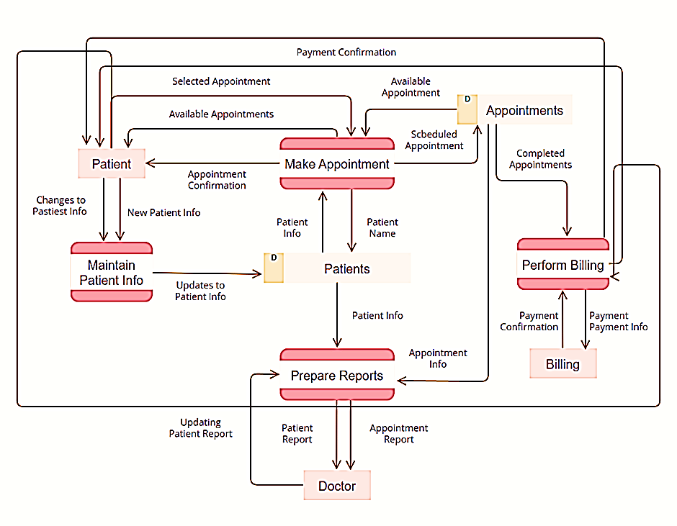
DATA FLOW DIAGRAM

Slide 6
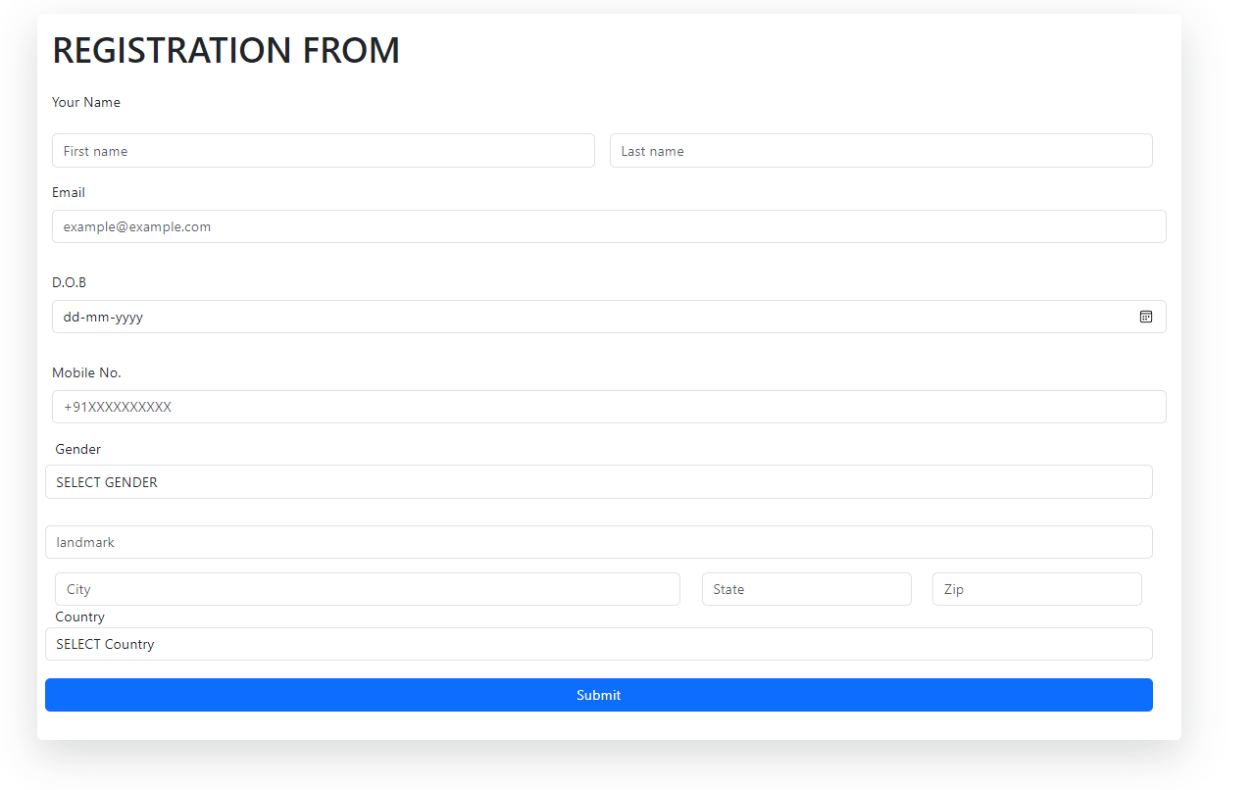
SIGN UP PAGE

Slide 7

LOGIN PAGE

Slide 8
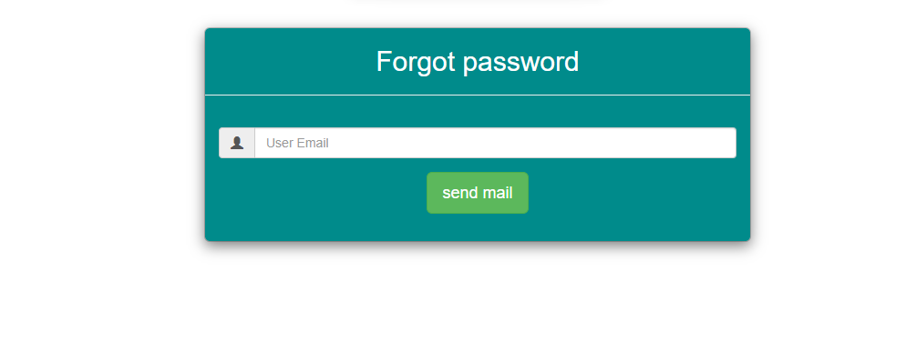
FORGOT PASSWORD PAGE

Slide 9
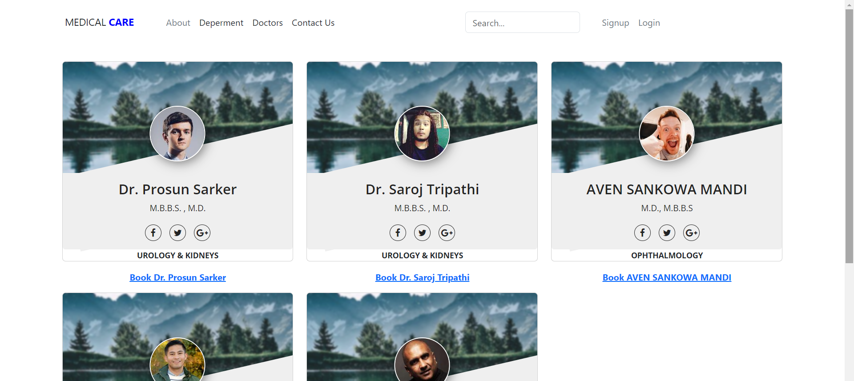
DOCTOR’S PROFILE PAGE

Slide 10
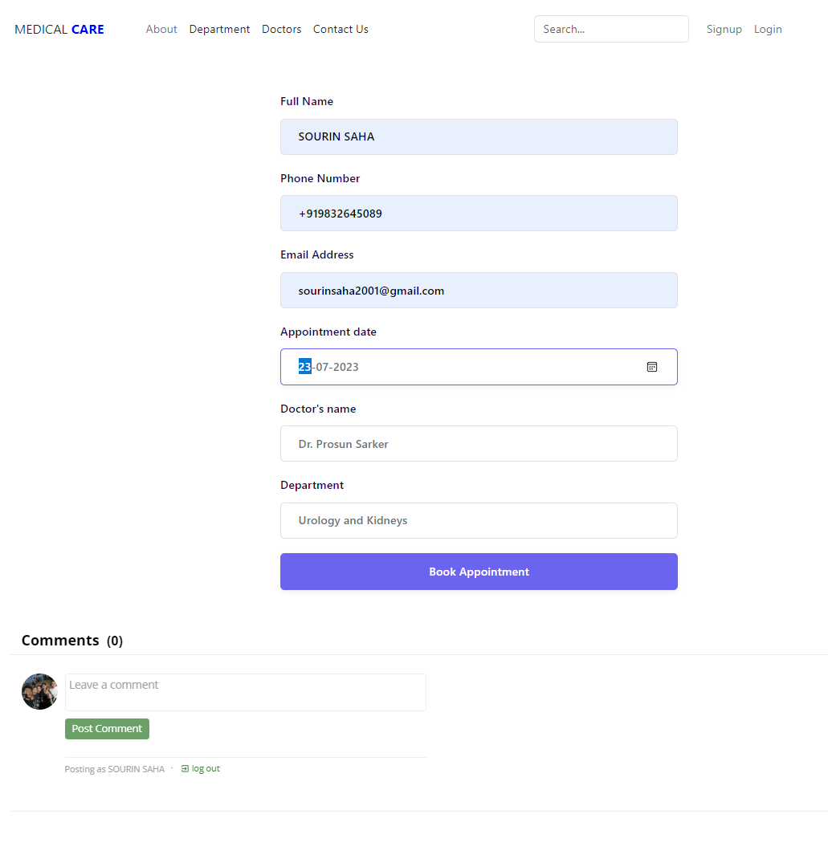
BOOKING PAGE

Slide 11

DOCTOR LOGIN PAGE

Slide 12
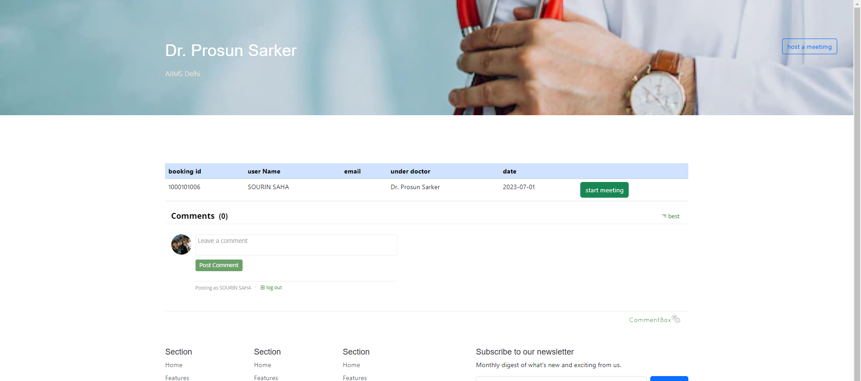
DOCTOR DASHBOARD

Slide 13
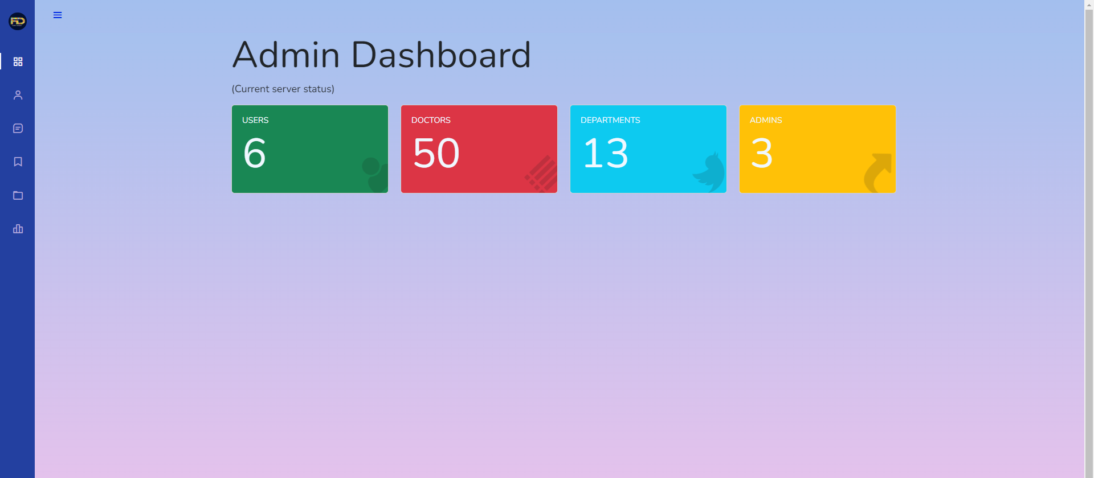
ADMIN PAGE

Slide 14
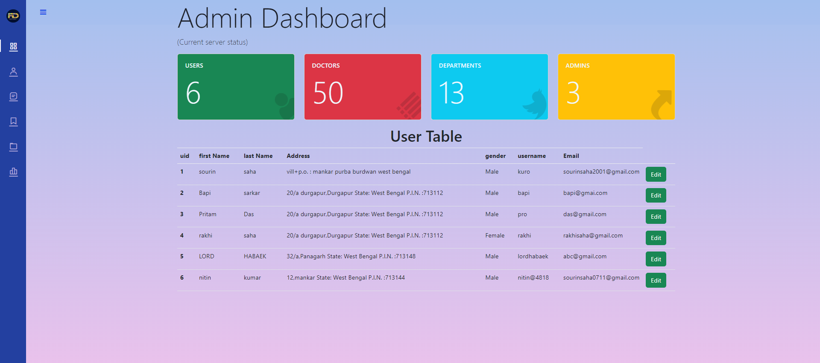
USER MANAGEMET IN ADMIN PAGE

Slide 15
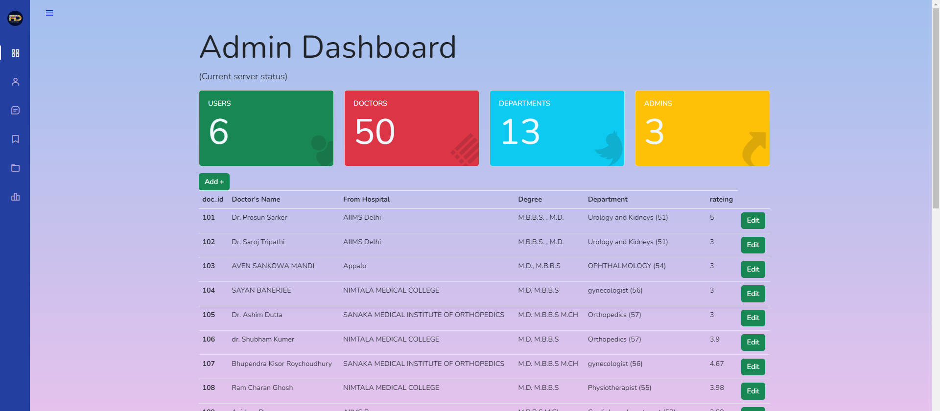
DOCTOR MANAGEMENT

Slide 16
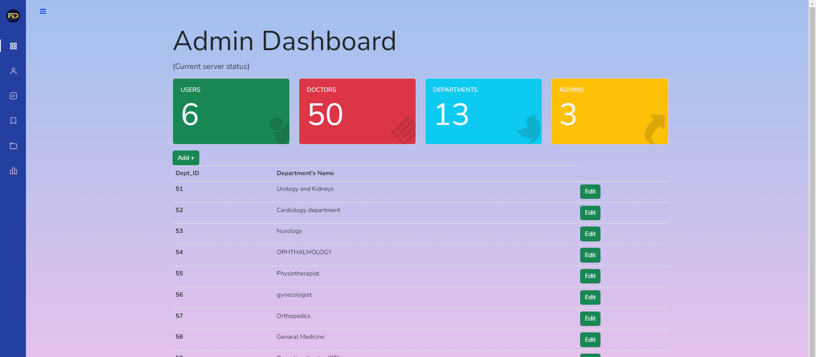
DEPARTMENT MANAGEMENT

Slide 17
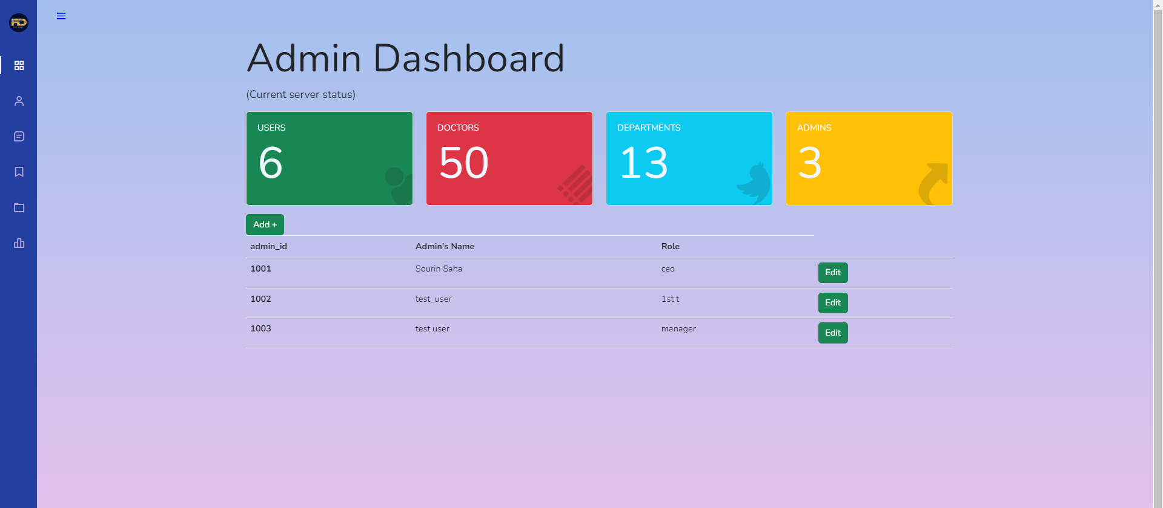
ADMIN AND FECALTY MANAGEMET

Slide 18

THANK YOU

